Slide 1
Stat 495r – Presenting Data
Week 3
Gestalt Principals

Slide 2
Data Vizzes of the Week

Slide 3

Data Viz #1

Slide 4
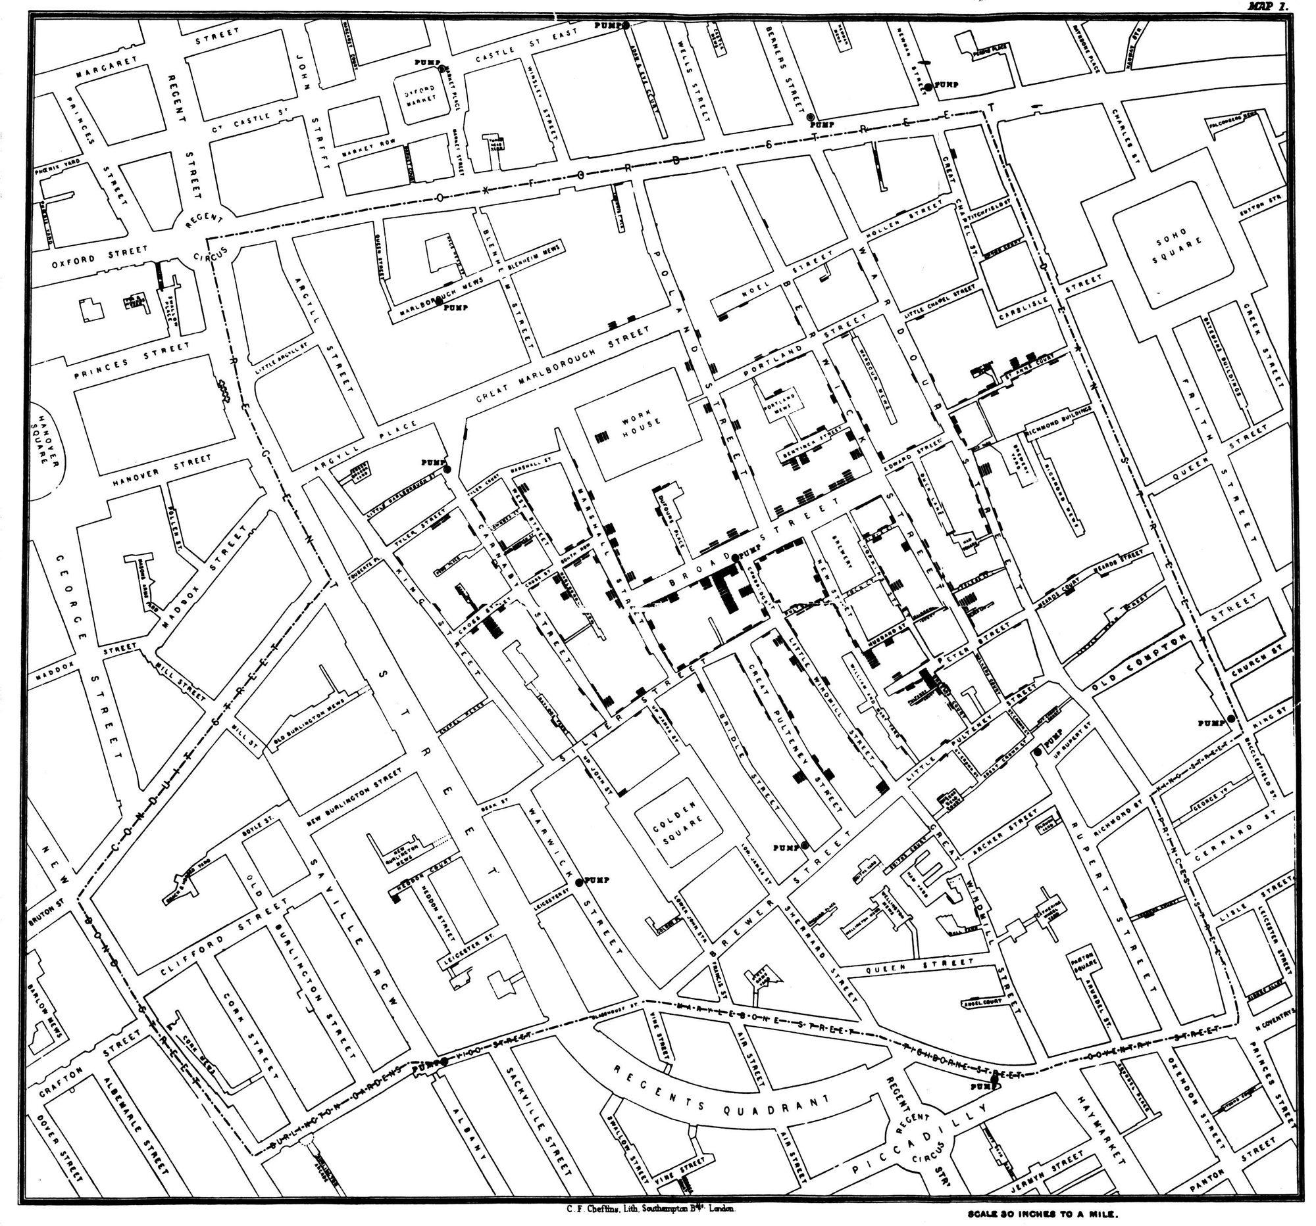
Data Viz #2

Slide 5
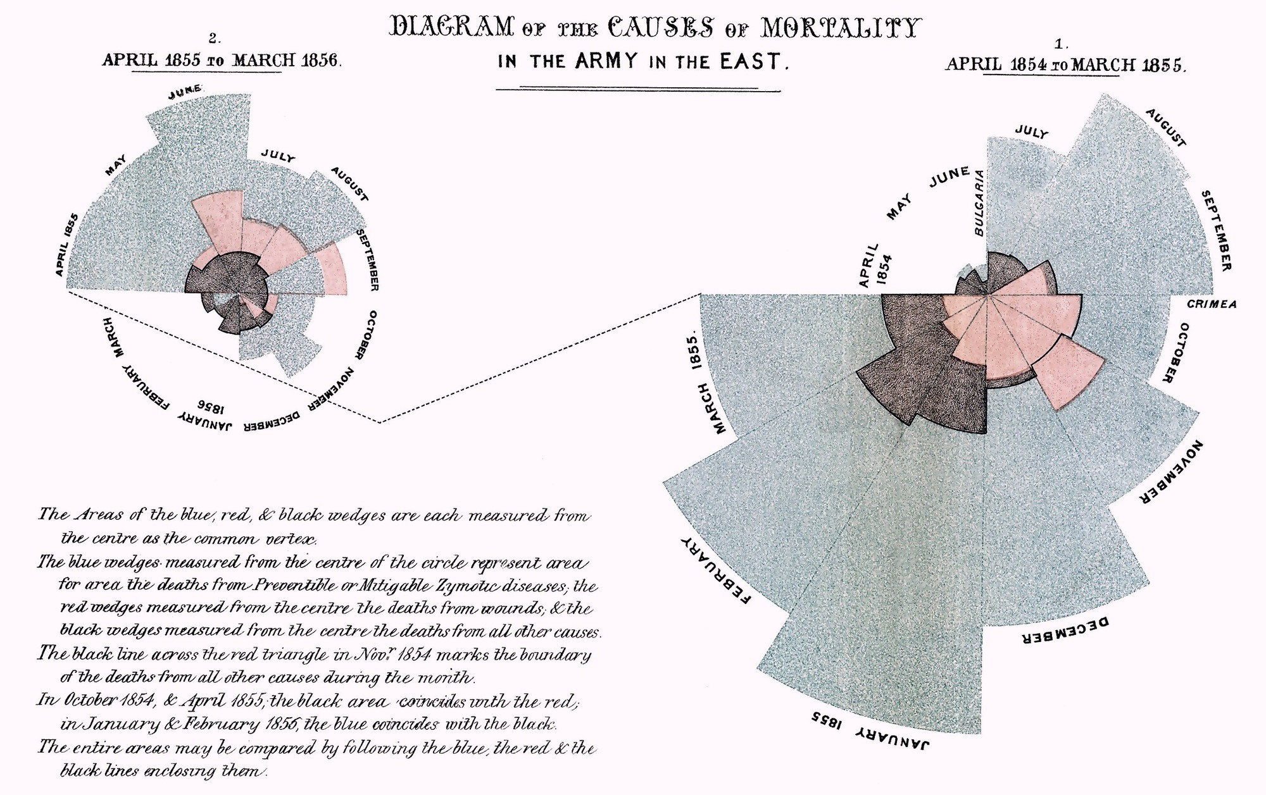
Data Viz #3

Slide 6

Quote of the Week
The Non-Reciprocal Law of Visualization Creation and Consumption.
No special skills are required to understand a visualization. However, many special skills are required to creation one.

Slide 7
Book Club Time

Slide 8
Gestalt Principals

Slide 9
Statistics alone do not tell the whole
11 data points
x-value average = 9
x-value variance = 11
y-value average = 7.5
y-value variance = 4.12
Correlation = 0.816
Linear regression y = 3.0 + 0.5x
Sketch a chart that shows what you think the data points will be.

Slide 10
Anscombe’s Quartet

Slide 11
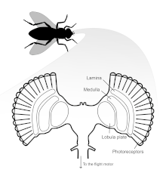
Humans are hardwired to notice some visual properties without thinking
Flies see motion better
Birds see color better
Nocturnal critters see hues better

Slide 12
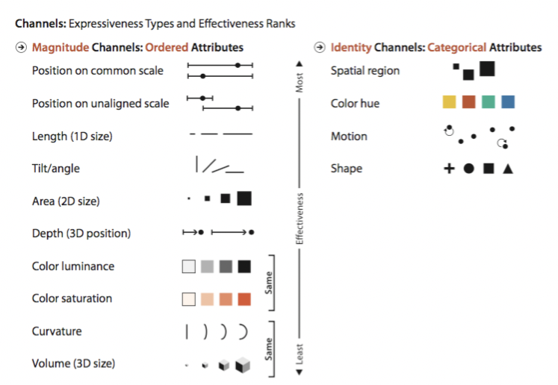
What are human’s hardwired to see?

Slide 13
Find the small dots

Slide 14
Find the small dots

Slide 15
Find the small red dots

Slide 16
These boxes are the same shade of black

Slide 17

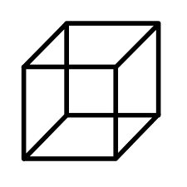
Marks
Points
Lines
Areas
Channels
Horizontal
Vertical
Both
Color
Tilt
Position
Length
Area
Volume

Slide 18
What marks and channels are being used?

Slide 19
What marks and channels are being used?

Slide 21
Accuracy in Perceived visuals

Slide 22
Separating Channels
2 Positions + 2 Colors = Full Separable
2 Sizes + 2 Hues = Some Interference
2 widths + 2 heights = Sig Interference
4 colors = Sig Interference

Slide 23
Activity

Slide 24
Activity
Find a partner
Find a data visual you have done for homework in this class (or another class), save it as a single slide
Share you visual with your partner (5 minutes)
Take 20 minutes and make changes (improvements hopefully) to the visual, make notes of what changes you make
Swap slides back and discuss the changes that you made (10 minutes)
Share with the class (20 minutes)

Slide 25
Key Takeaways
Data visualization has some cool history
Consider the marks and channels used in your visualizations
Don’t use more than 2-3 channels and prioritize better channels

Slide 26
Homework

Slide 27
Homework #1
Make a data viz to describe yourself that can be shared with the class
The data viz should convey some story and information about yourself personally. The data can be concrete or ethereal (e.g. you make it up). Possible sources include:
GitHub commits
Courses taken at BYU
Career timeline
Self-ratings of different skills or hobbies

Slide 28
Homework #2
Improve the viz which shoes the number of cars sold by a national chain of dealerships. What unnecessary visual elements could you eliminate? What other changes would reduce cognitive burden?

Slide 29
Homework #3
A company that installs solar panels provides their installers with a bonus based on responses to a survey that homeowners take following installation
Installers bring iPads with them and hand the iPad survey to the homeowner before leaving
There is a high potential for abuse – there are reports of installers taking the survey themselves or coercing homeowners into providing high marks
Historically, bonuses have been based on NPS averages but the company plans to move to CSAT
How likely are you to recommend this installer? NPS = # of promoters (9-10) minus detractors (0-6). This doesn’t make sense for many reasons, especially because homeowners can’t pick or request installers – they are assigned.
How satisfied are you with this installer? CSAT is 1 to 5 scale
At the forthcoming monthly all-hands meeting you are allotted 5 minutes to explain the change, but any changes to compensation have/will cause installers to “freak out!”
Create a 5 minute presentation (1-2 slides max) explain the change to installers (non-technical folks) and provide a data visual that will help them not “freak out.”

Slide 30
Post-class Reading
You should have read chapters 1, 2, 3, 4, 5 and 6 in Storytelling with Data by now – if not catch up
In lieu of reading more chapters, watch this 20m video and come ready to discuss next week:
Hans Rosling | The best stats you’ve every seen | TED 2006
https://www.ted.com/talks/hans_rosling_the_best_stats_you_ve_ever_seen

